Slide 1

Spotify
Song Clusters
December 13, 2022

Slide 2

Overview
Music can boost every mood whether it’s for the gym, study, or work. Finding that one song that you put on repeat is great, but finding multiple songs like that is even better!
As a casual listener, song clustering can help us find songs similar to the ones we love that’s on constant repeat!
For businesses, song clusterings can be used to help recommend like songs to customers and thereby increasing customer satisfaction/retention.

Slide 3
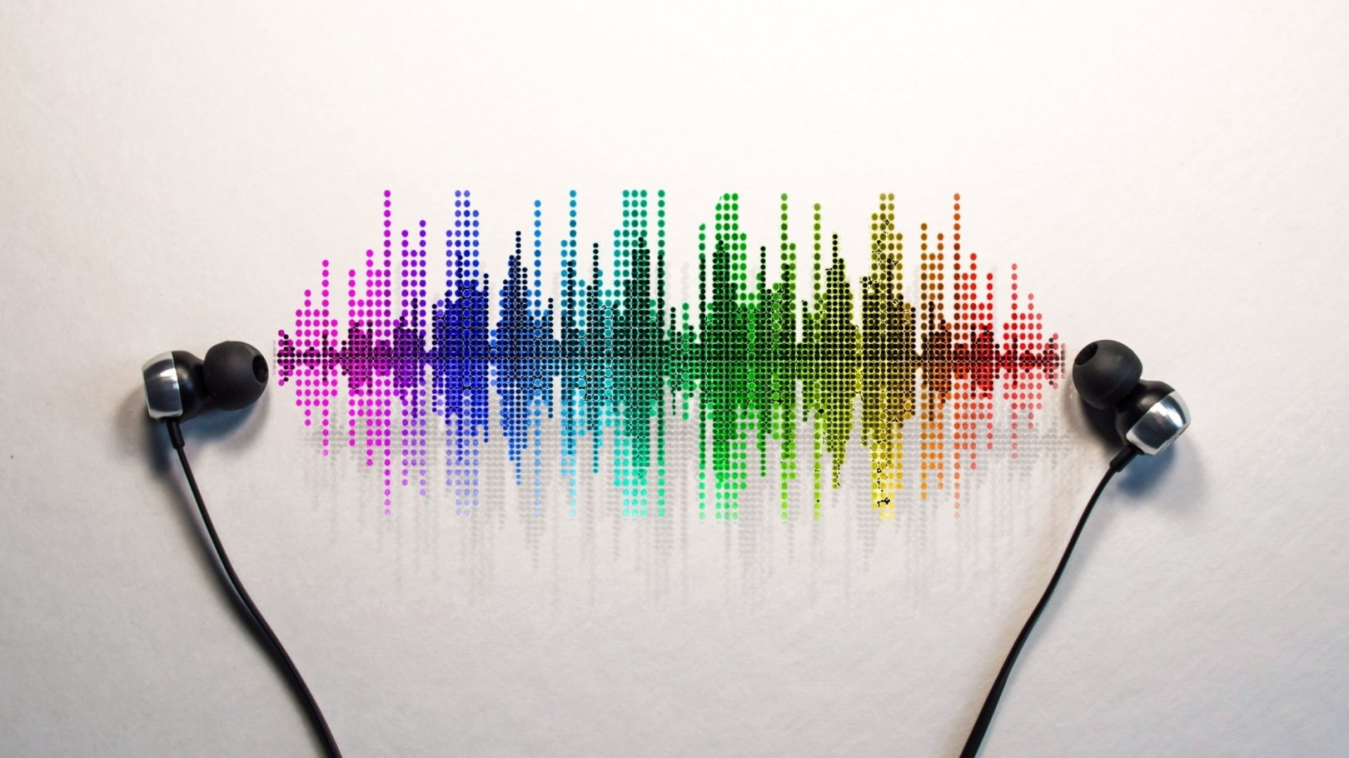
Research Question
Can songs be grouped into clusters based on features (tempo, key, liveness etc.)?
If so, how well?
How many clusters?

Slide 4
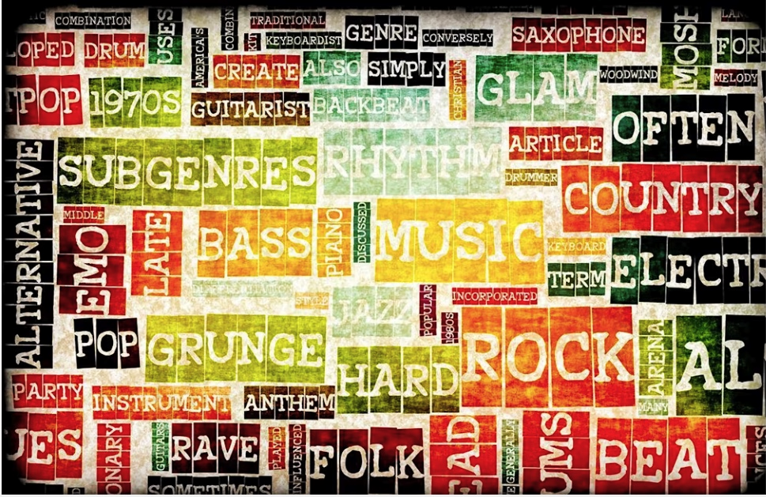
The Data
The data: Spotify Music Data
There are 19 qualities (features) that are a part of the songs database.
The songs spanned many different genres and released from 1920-2020.
Here’s what we did…

Slide 5
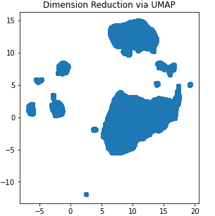
Model Construction
Text features that provided no significant value were removed.
Dimensionality reduction (UMAP) was used to reduce noise, run time, visualize approx number of clusters: ~10-11 clusters
DBscan was ran first to also approximate number of clusters: ~ 12 clusters.

Slide 6
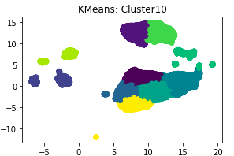
Model Comparison and Selection
Silhouette Scores
Cluster partitioning was consistent across KMeans and Gaussian Mixture Model (GMM)
KMeans had the highest Silhouette Score at 10 clusters and therefore is the chosen Model for this data set.
Room for improvements: (1) Split data set to verify consistent clustering for KMeans at 10 clusters. (2) Try different number of components in UMAP.
Clusters | KMeans | GMM | DBScan
10 | 0.4711 | 0.4395
11 | 0.4651 | 0.4504
12 | 0.4538 | 0.4482 | 0.2364

Slide 7
Conclusion and Recommendation
KMeans model was selected amongst 2 other models. It was able to cluster the song libraries into 10 different clusters with a silhouette score of 0.4711.
The use of this tool can help Spotify create another way of recommending songs by giving them the ability to determine similar songs within the same clusters.
Recommendations…
(1) Running the results with different number of components in UMAP to improve silhouette score if needed. (2) Using this tool in conjunction with a genre clustering to potentially give better song recommendations.

